Slide 1
MALL MANAGEMENT SYSTEM
PRASANTH KANDIPALLI PRASANTH SAI GUMPALLI
110CS0141 110CS0479

Slide 2
Objective
To simplify the end user’s day-to-day jobs of managing a mall by a considerable amount through the automated system.

Slide 3
Functional Requirements
Admin
Manage shop creation requests
Activating/Deactivating shops
Statistics
Shop Owner
Shop Setup
Manage category/items
Statistics

Slide 4
Functional Requirements (Cont.…)
Customer
Add to cart
View cart
Checkout

Slide 5
Non-Functional Requirements
Performance Requirements
Logical Database Requirements
Design Constraints
Security

Slide 6
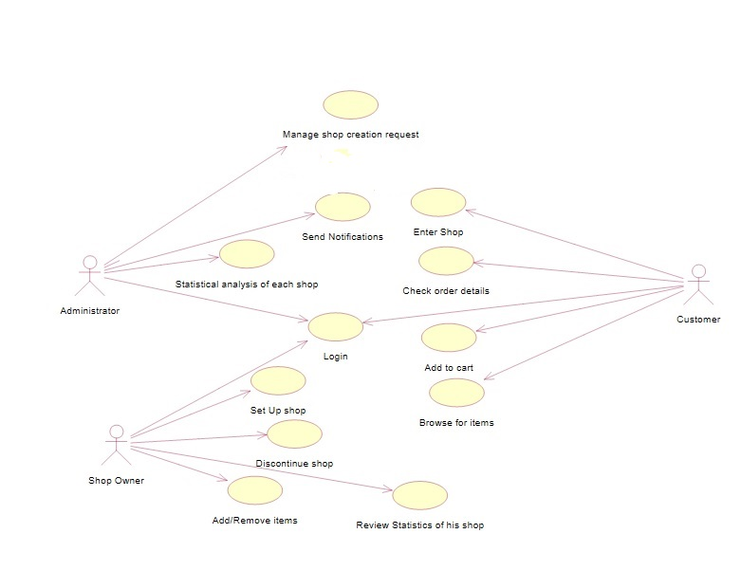
Use Case Diagram

Slide 7
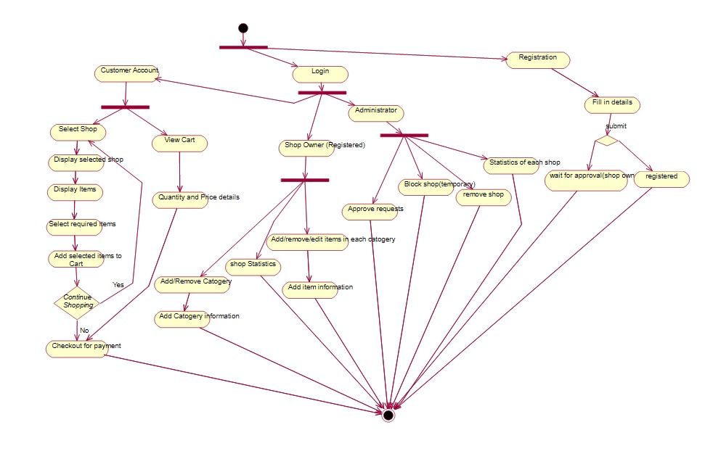
Activity Diagram

Slide 8
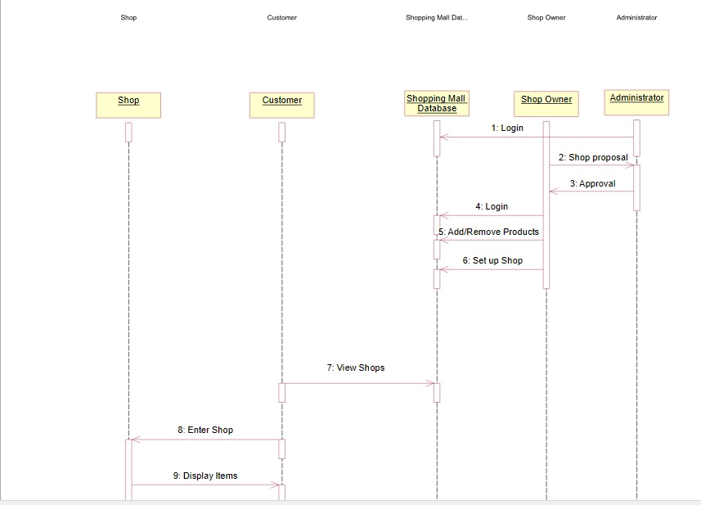
Sequence Diagram

Slide 9
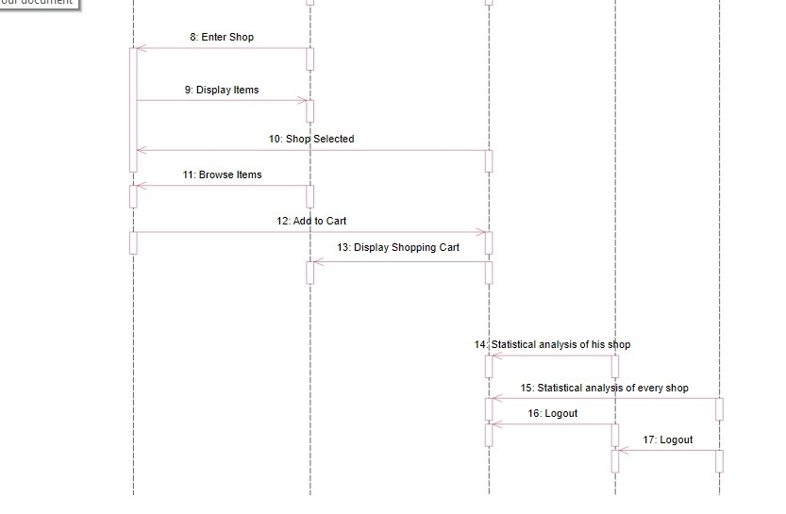
Sequence Diagram (Contd.)

Slide 10
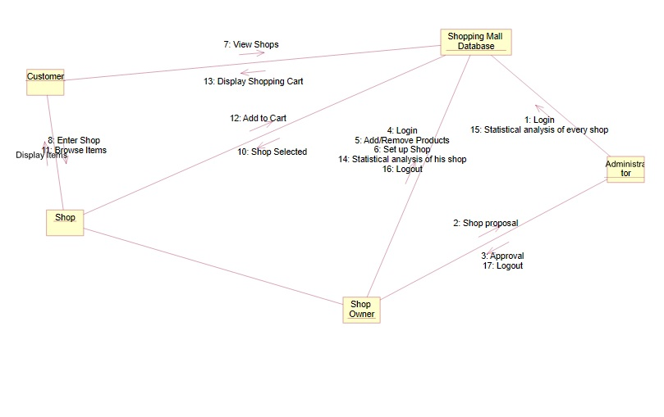
Collaboration Diagram

Slide 11
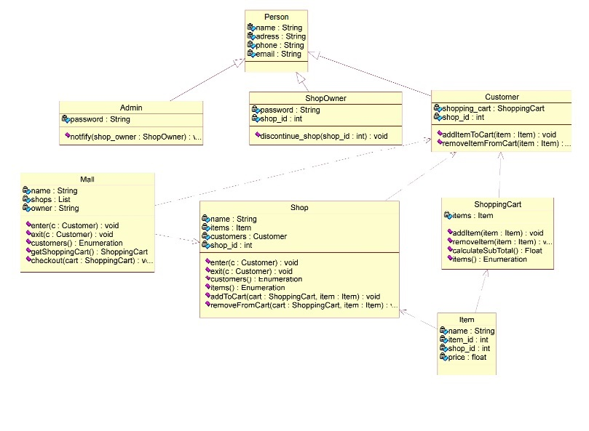
Class Diagram

Slide 12
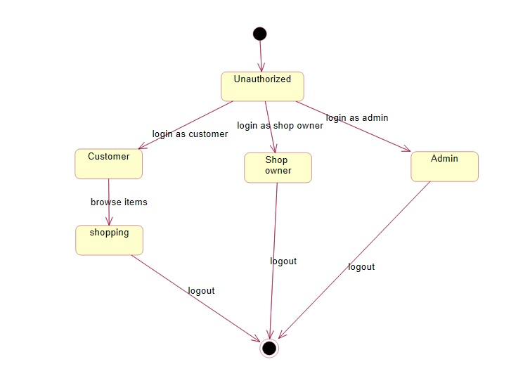
State Chart Diagram

Slide 13
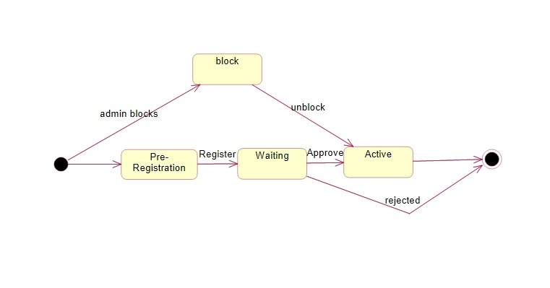
State Chart Diagram

Slide 14
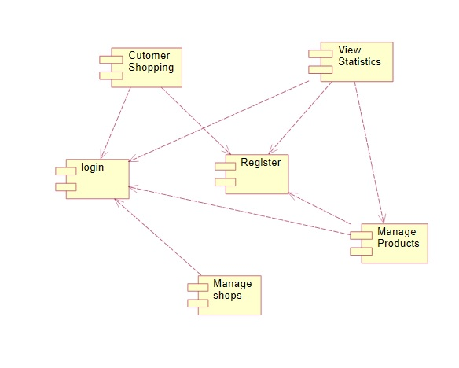
Component Diagram

Slide 15
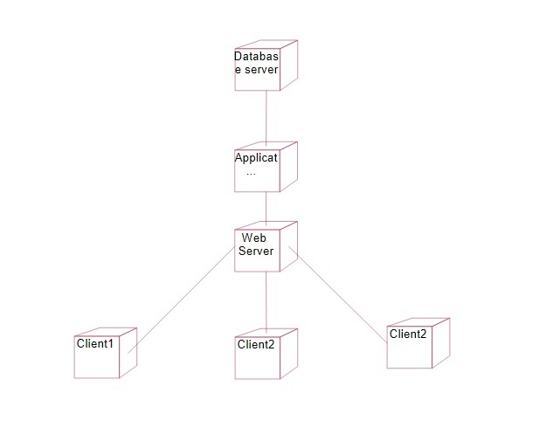
Deployment Diagram

Slide 16
Implementation…

